Slide 1

Hands_on_4
實作區域資料導向天氣預報模式:
FCNv2 及其擴充模組 與 RegPGW++ 整合應用
2025.11.19

Slide 2
04
PGW 2-way

Slide 3
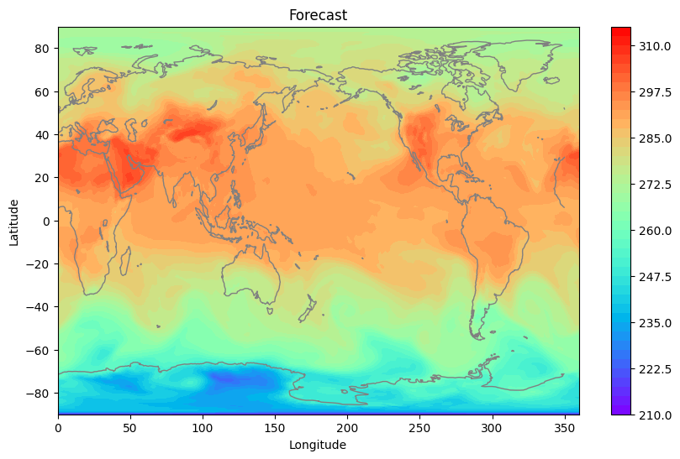
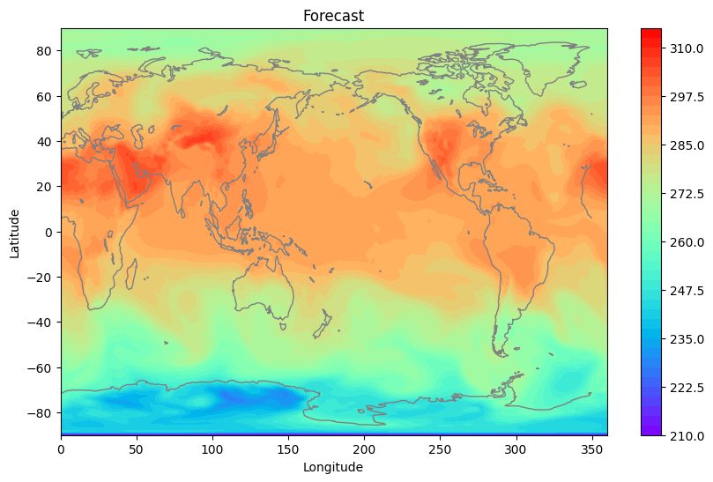
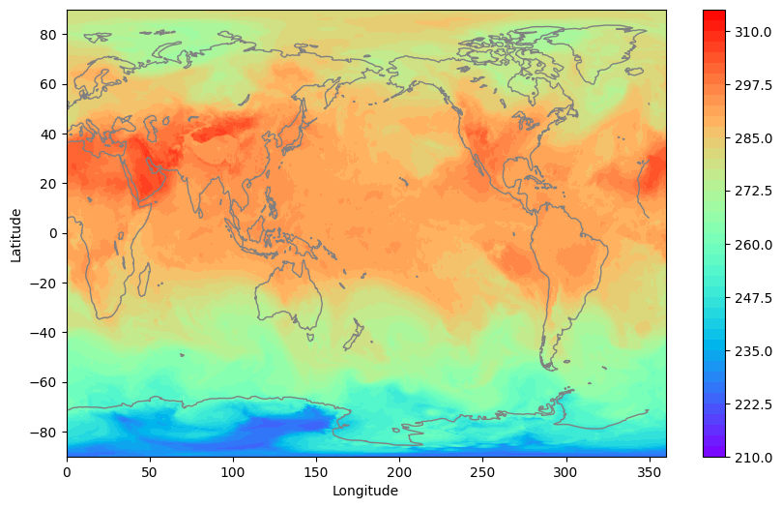
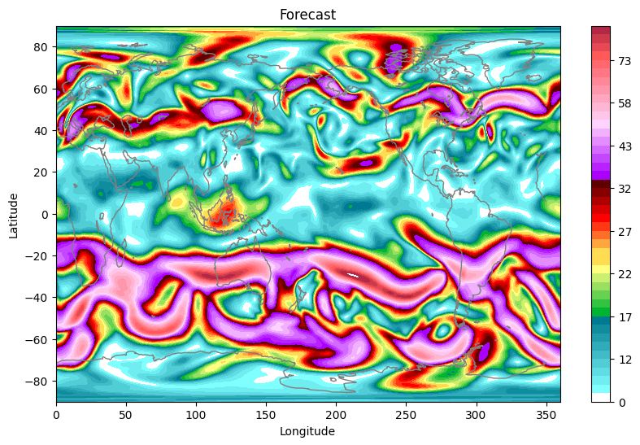
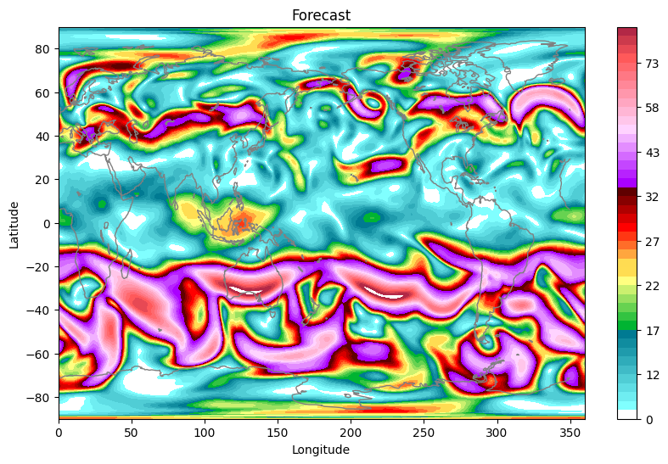
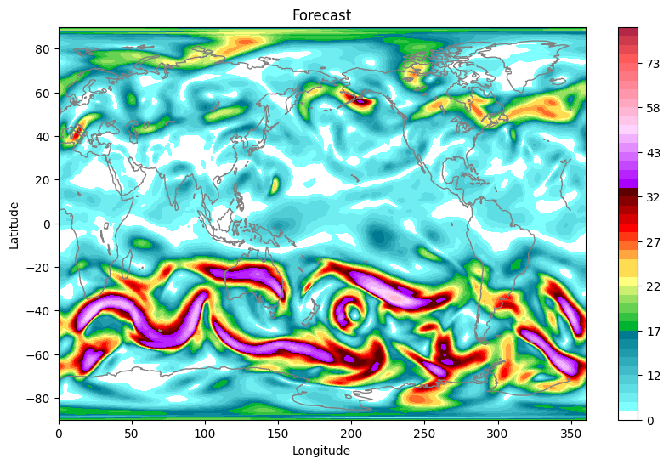
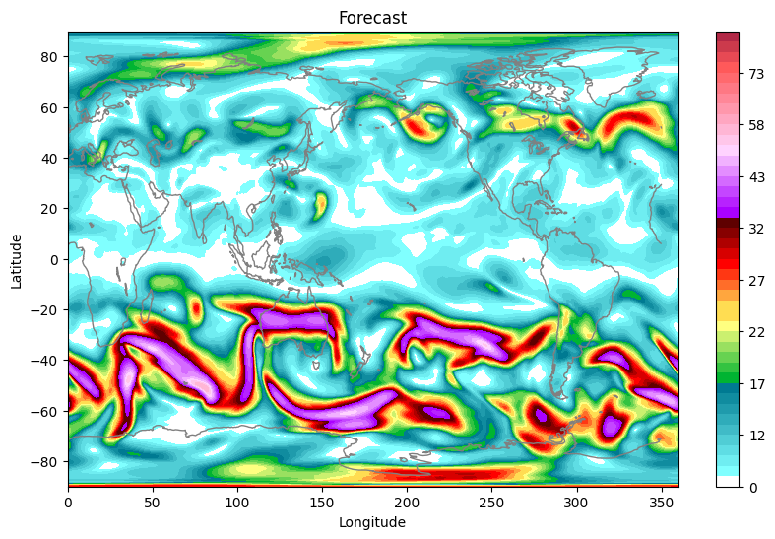
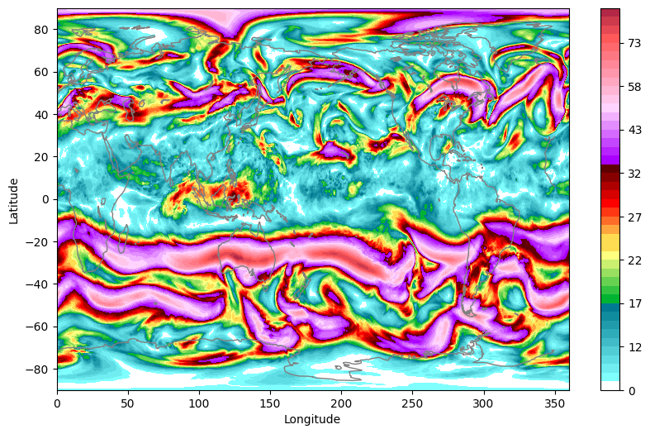
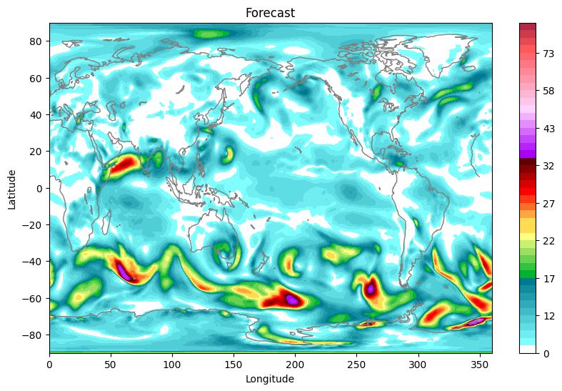
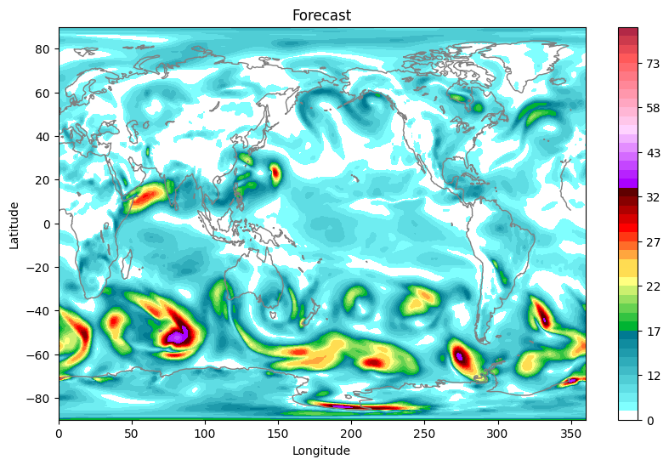
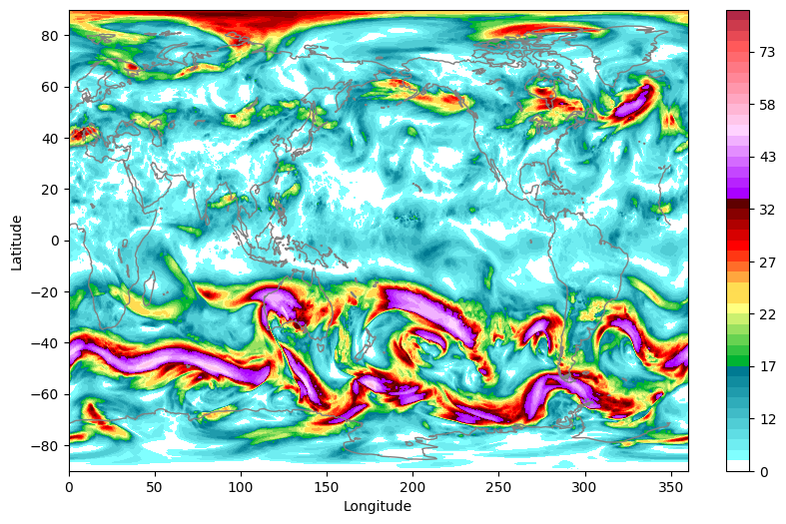
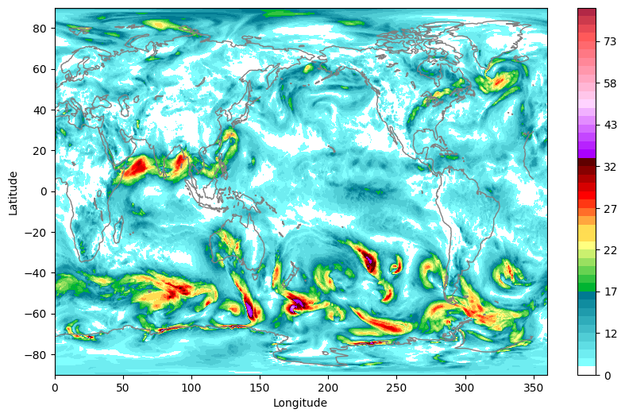
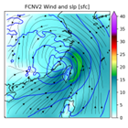
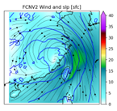
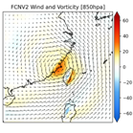
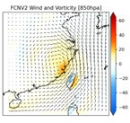
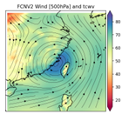
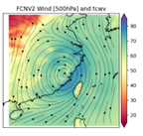
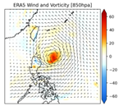
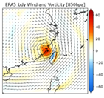
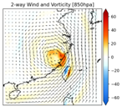
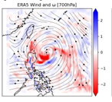
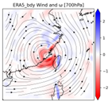
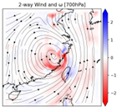
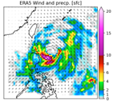
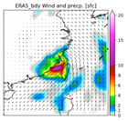
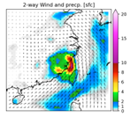
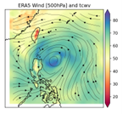
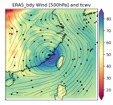
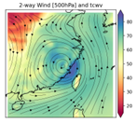
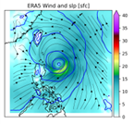
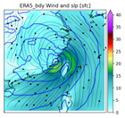
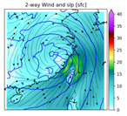
Coupling Strategy (one way)
Global model
FCNV2
FCNV2
Interaction module
…
One-way
One-way
Regional model
PGW++
PGW++
t
t+6
t+n

Slide 4

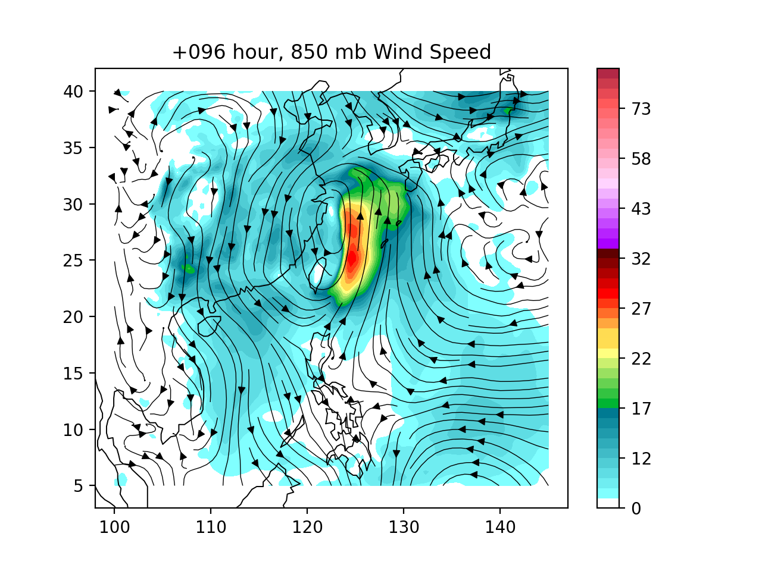
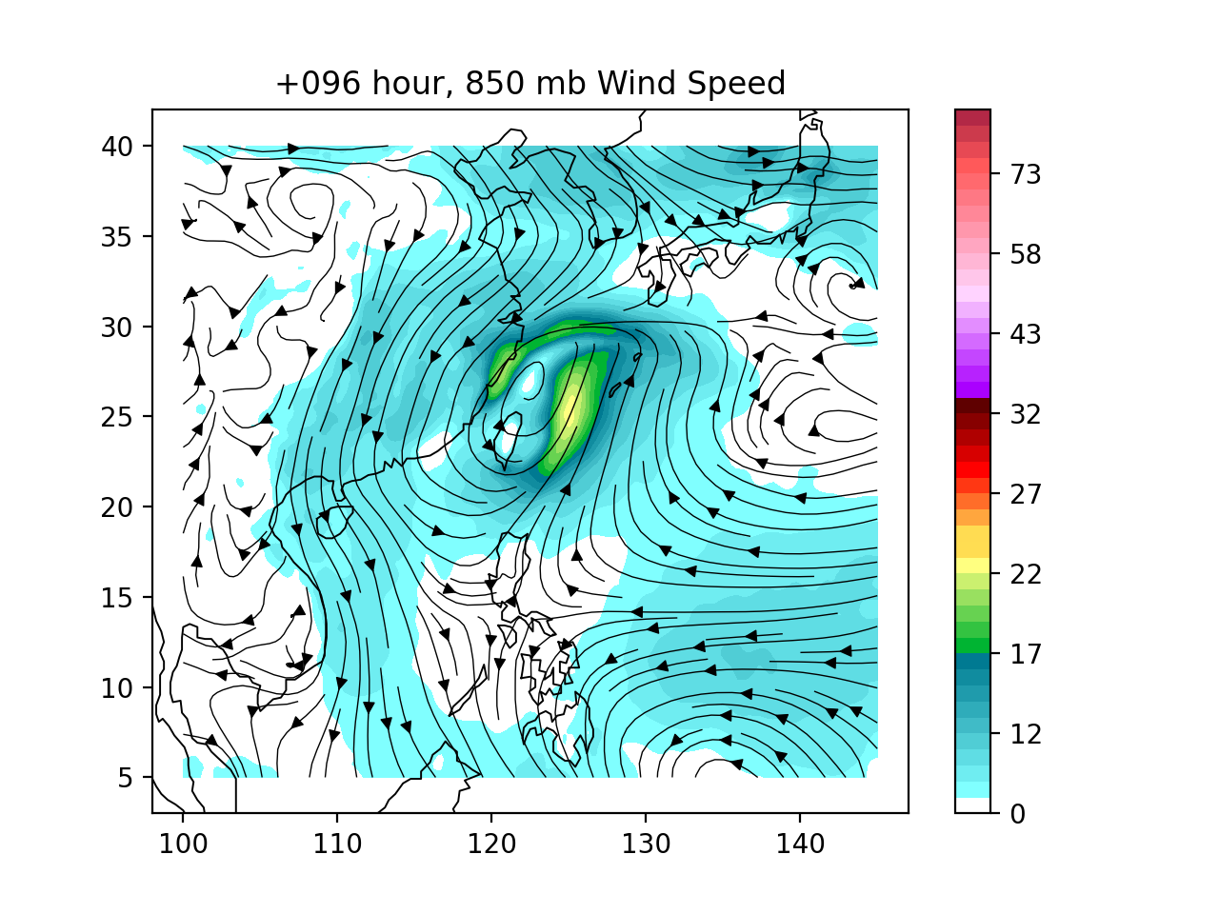
RegPGW++ with FCNv2 B.C. & nudging techniques
No boundary
FCNv2 boundary
FCNv2 nudging
(0.5*FCNv2) + (0.5*RegPGW++)
Notes:
1. [Summary] Configurations: free, boundary, nudging
2. 每6小時換boundary
3. 改圖、加FCN free run的圖
4. 動畫

Slide 5
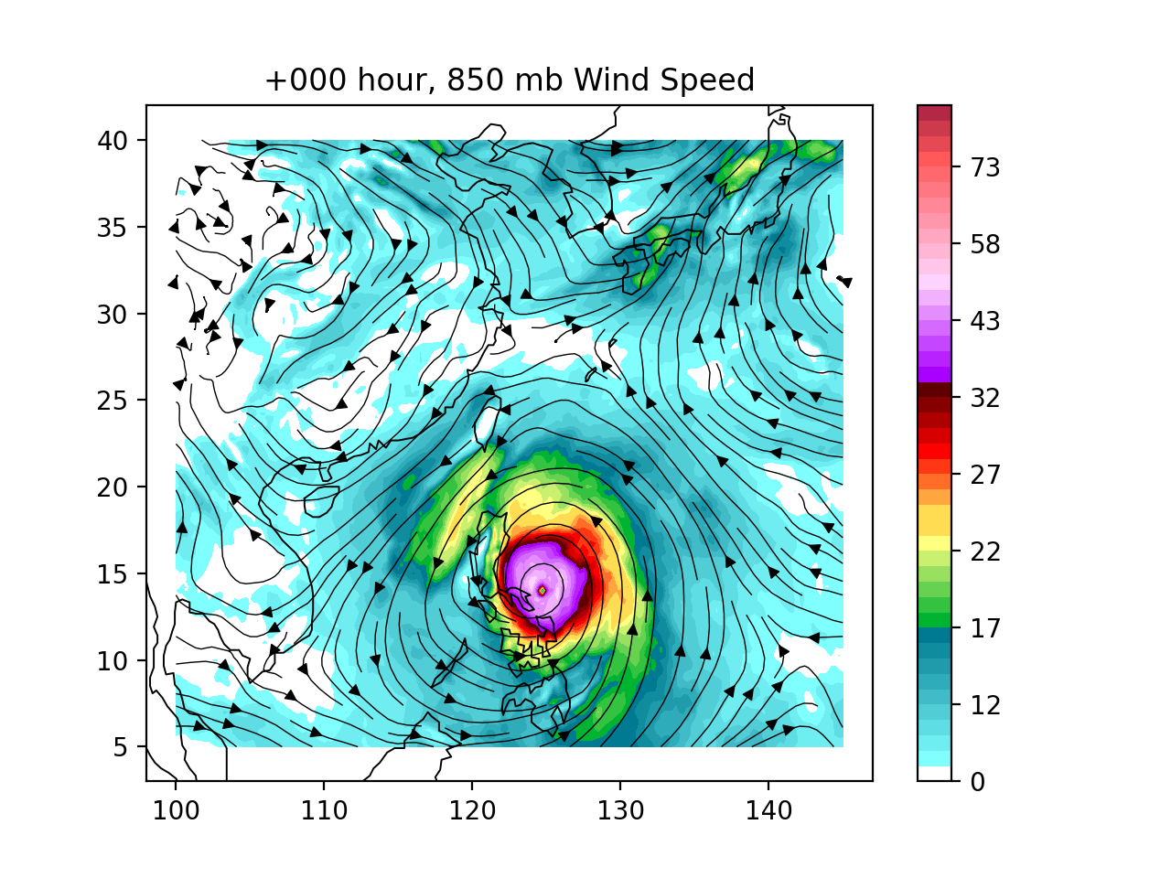
RegPGW++ with FCNv2 B.C. & nudging techniques
No boundary
FCNv2 boundary
FCNv2 nudging
Notes:
1. [Summary] Configurations: free, boundary, nudging
2. 每6小時換boundary
3. 改圖、加FCN free run的圖
4. 動畫

Slide 6
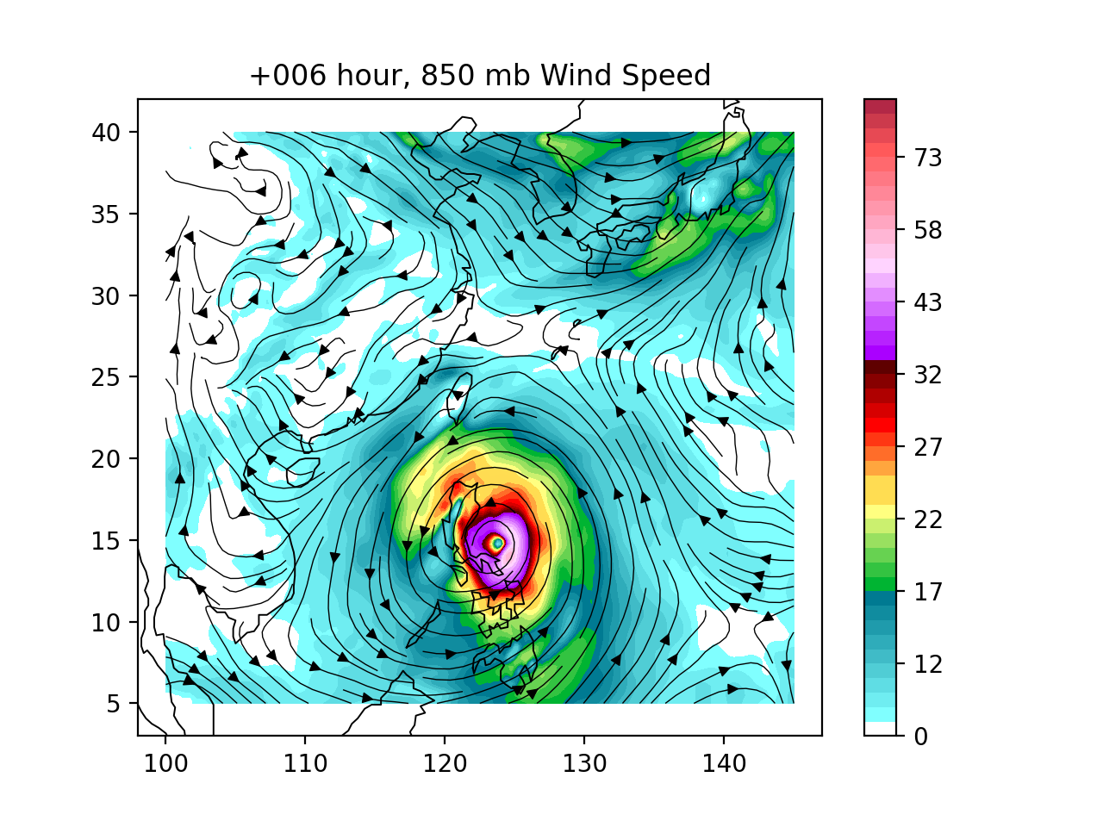
RegPGW++ with FCNv2 B.C. & nudging techniques
No boundary
FCNv2 boundary
FCNv2 nudging

Slide 7
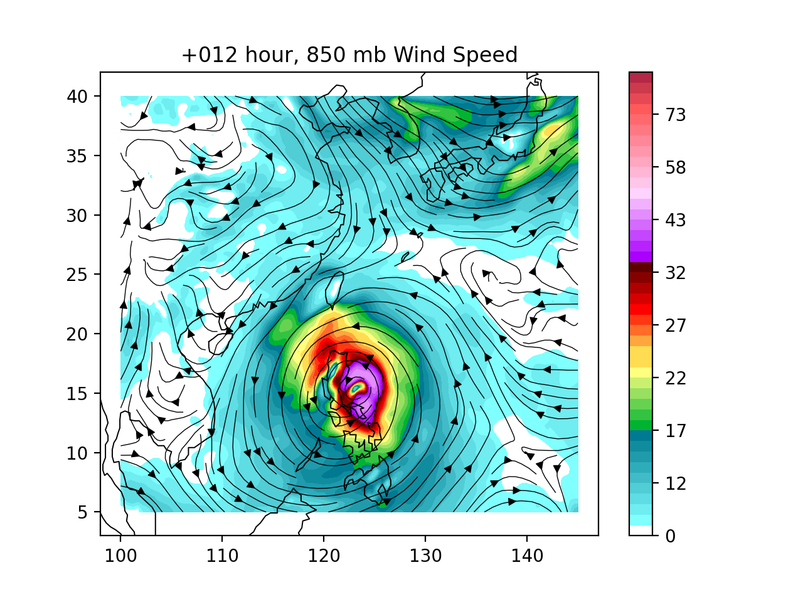
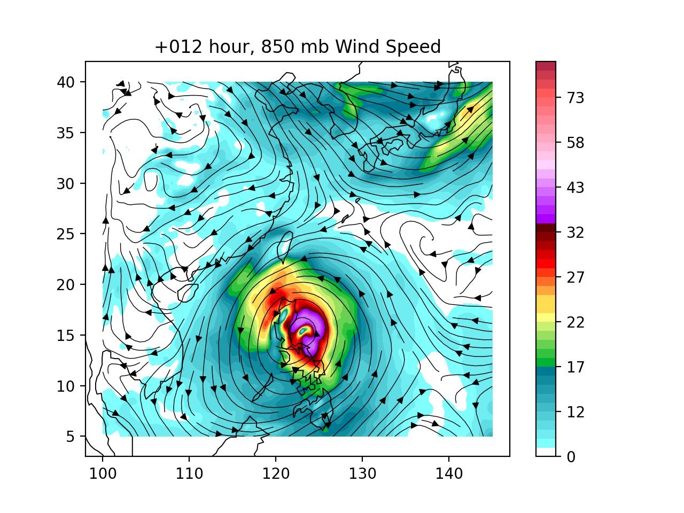
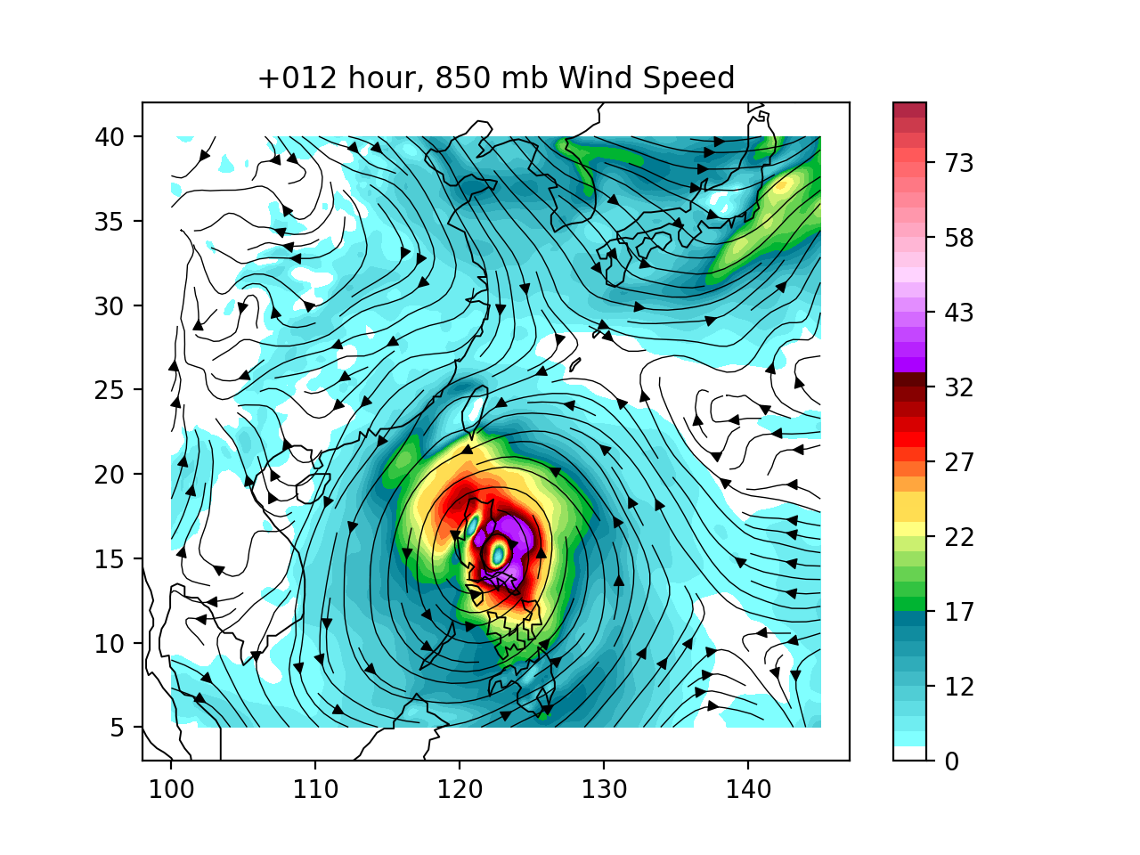
RegPGW++ with FCNv2 B.C. & nudging techniques
No boundary
FCNv2 boundary
FCNv2 nudging

Slide 8
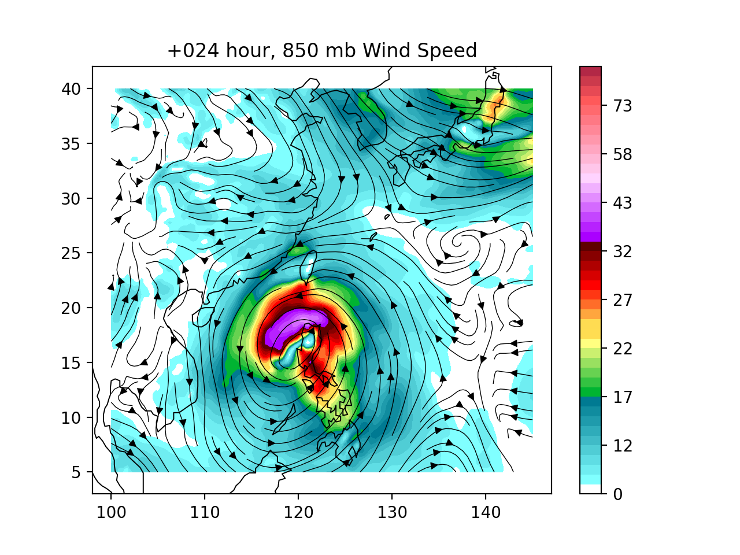
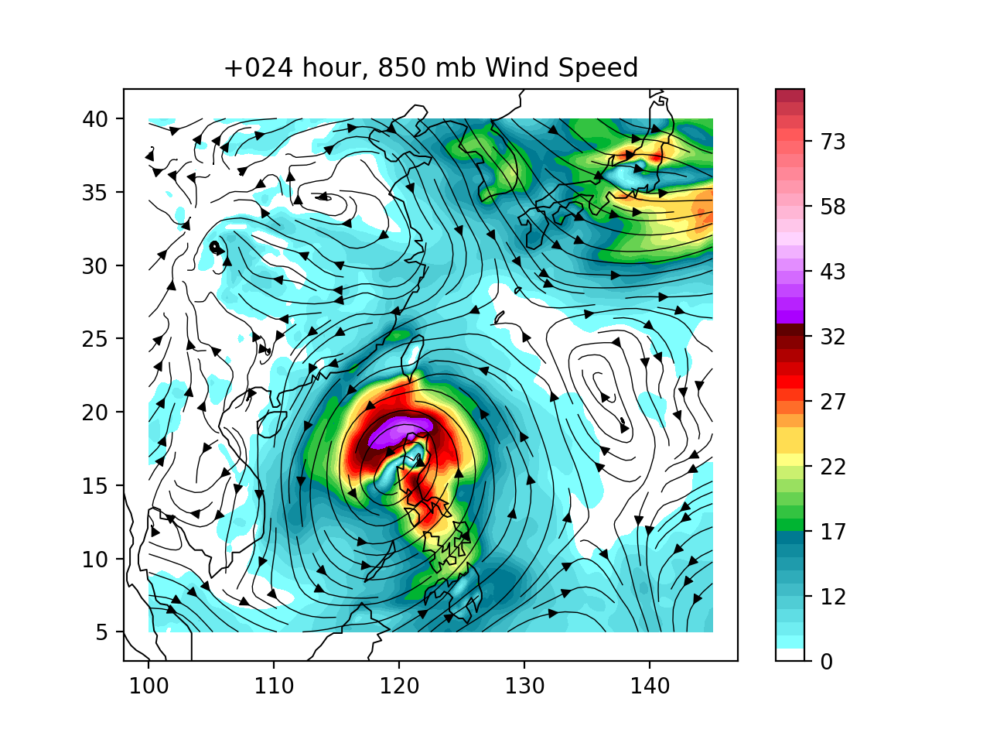
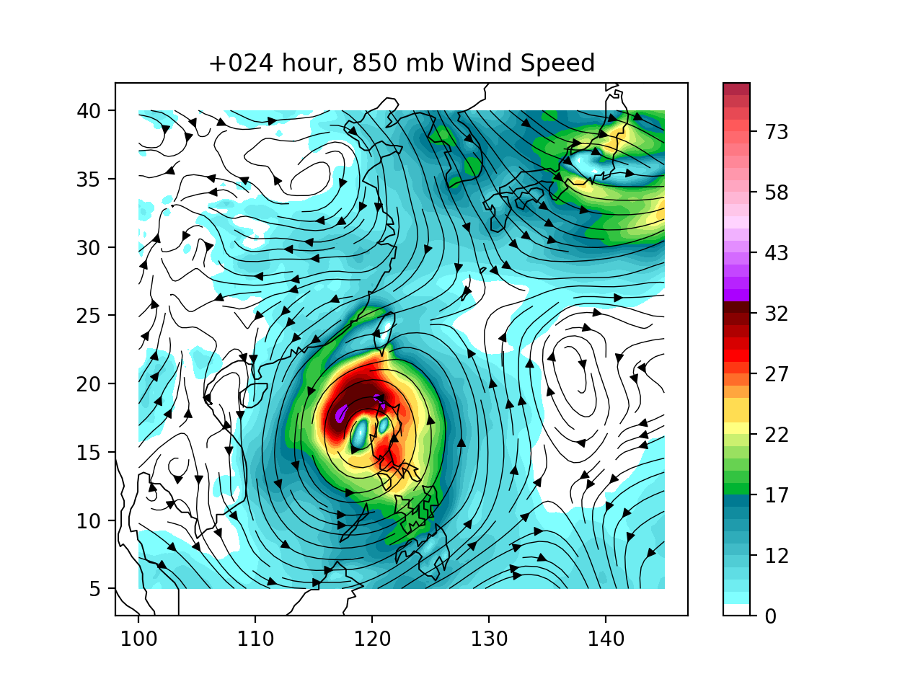
RegPGW++ with FCNv2 B.C. & nudging techniques
No boundary
FCNv2 boundary
FCNv2 nudging

Slide 9
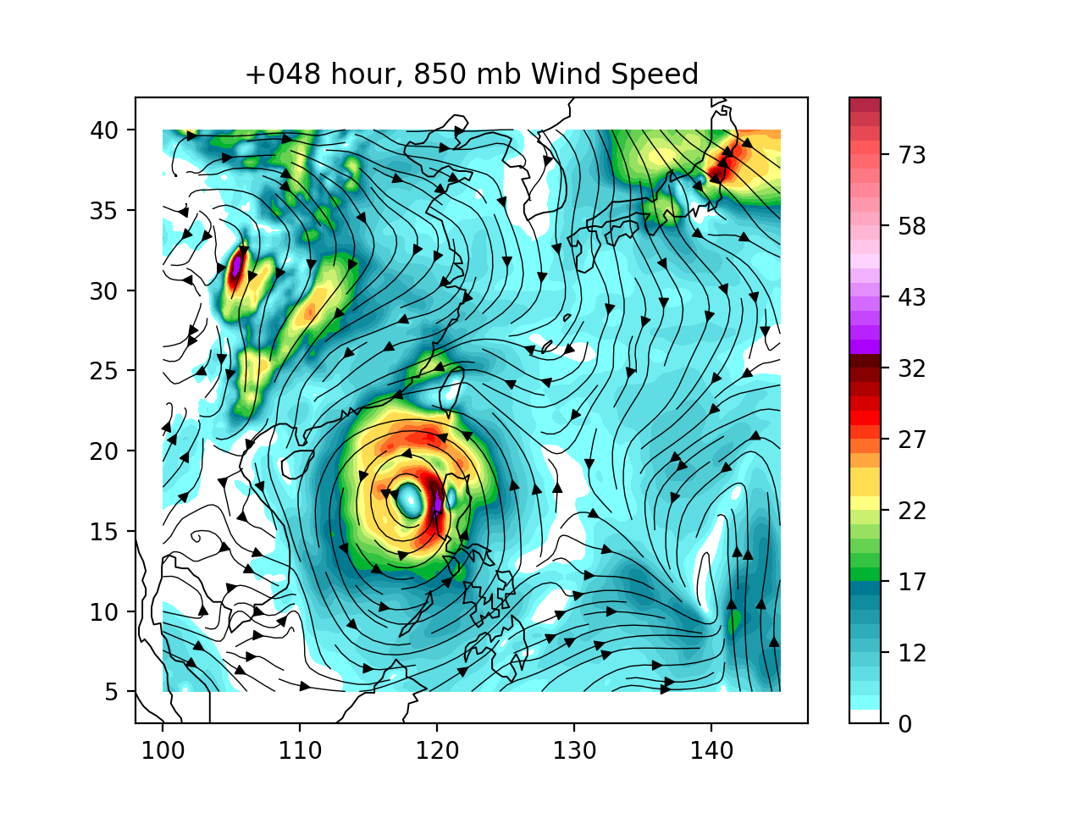
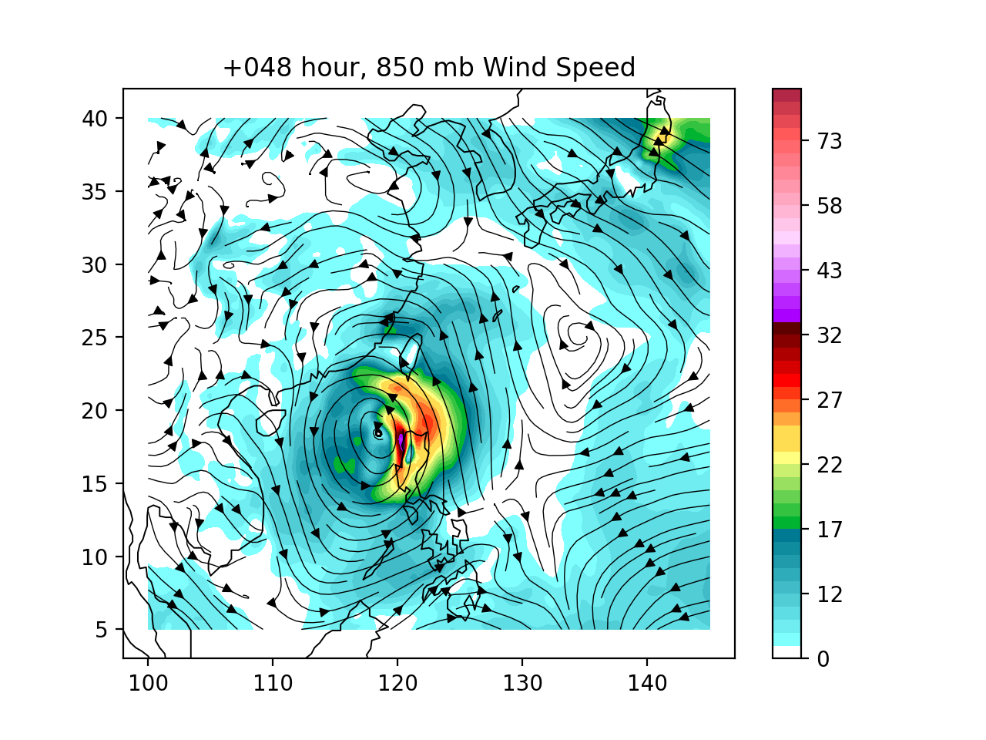
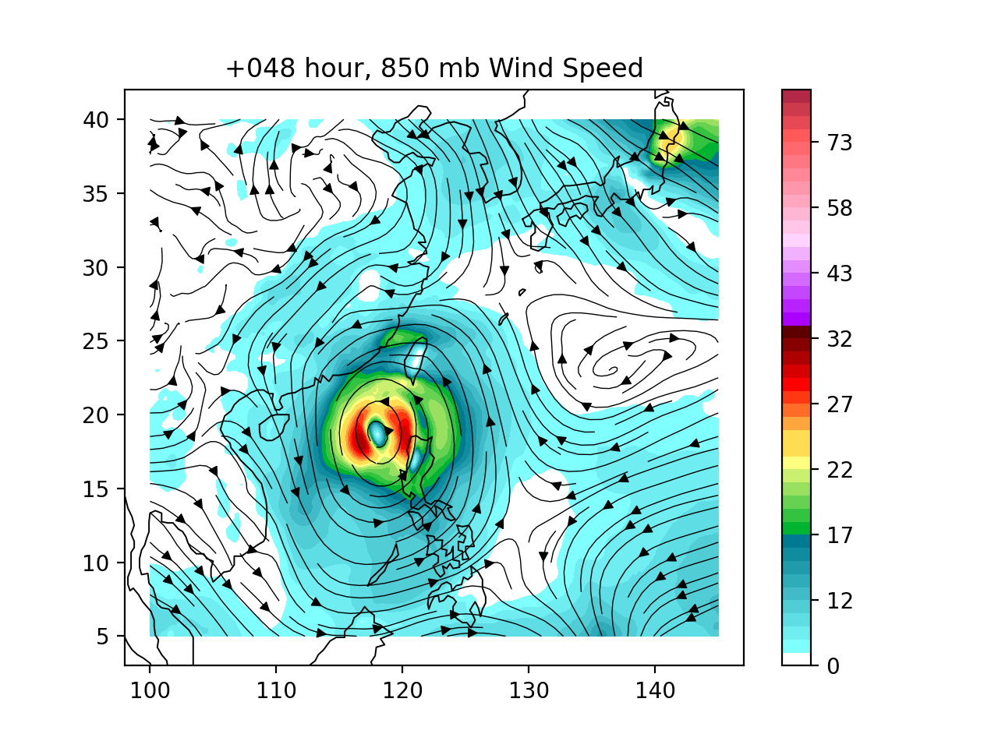
RegPGW++ with FCNv2 B.C. & nudging techniques
No boundary
FCNv2 boundary
FCNv2 nudging

Slide 10
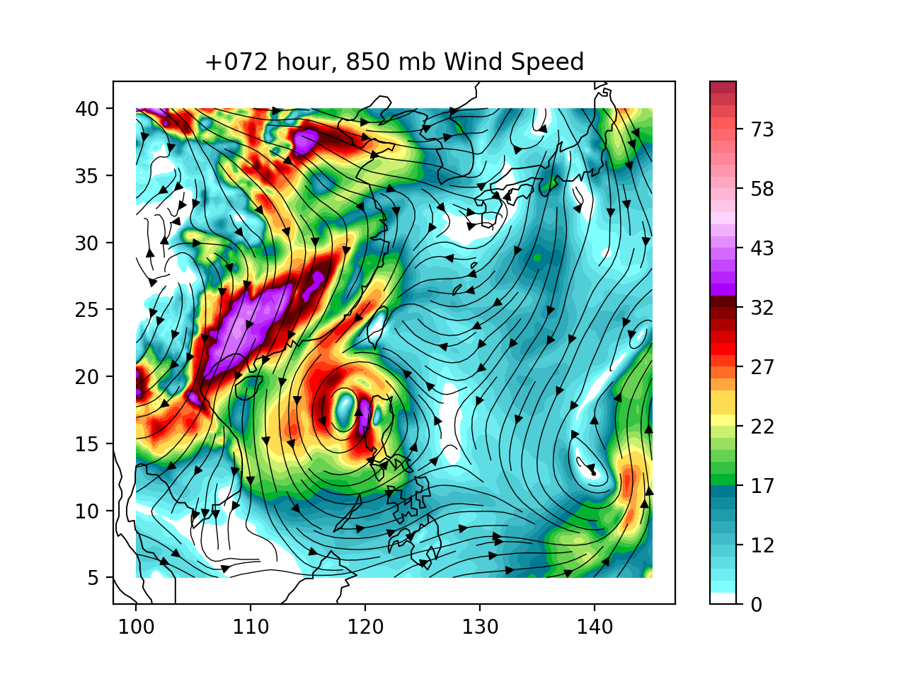
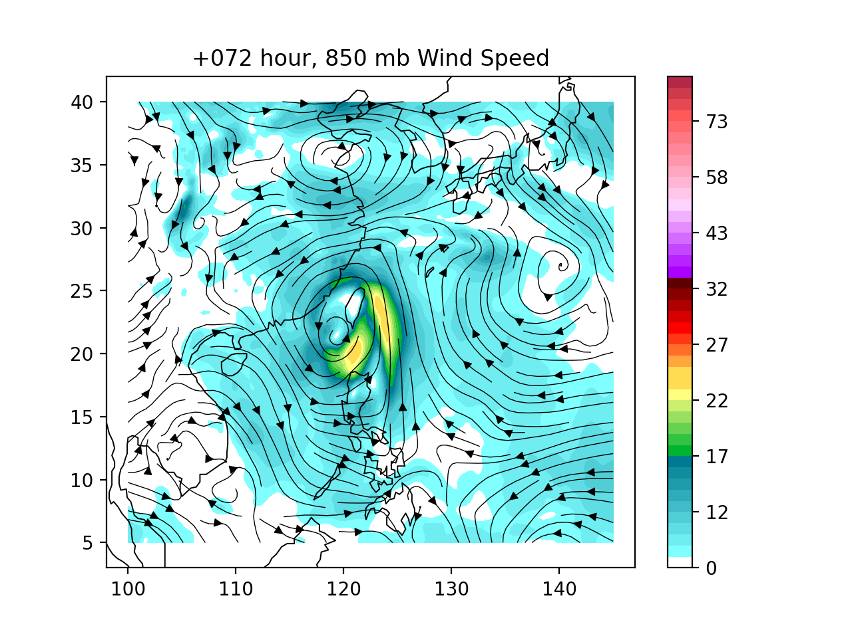
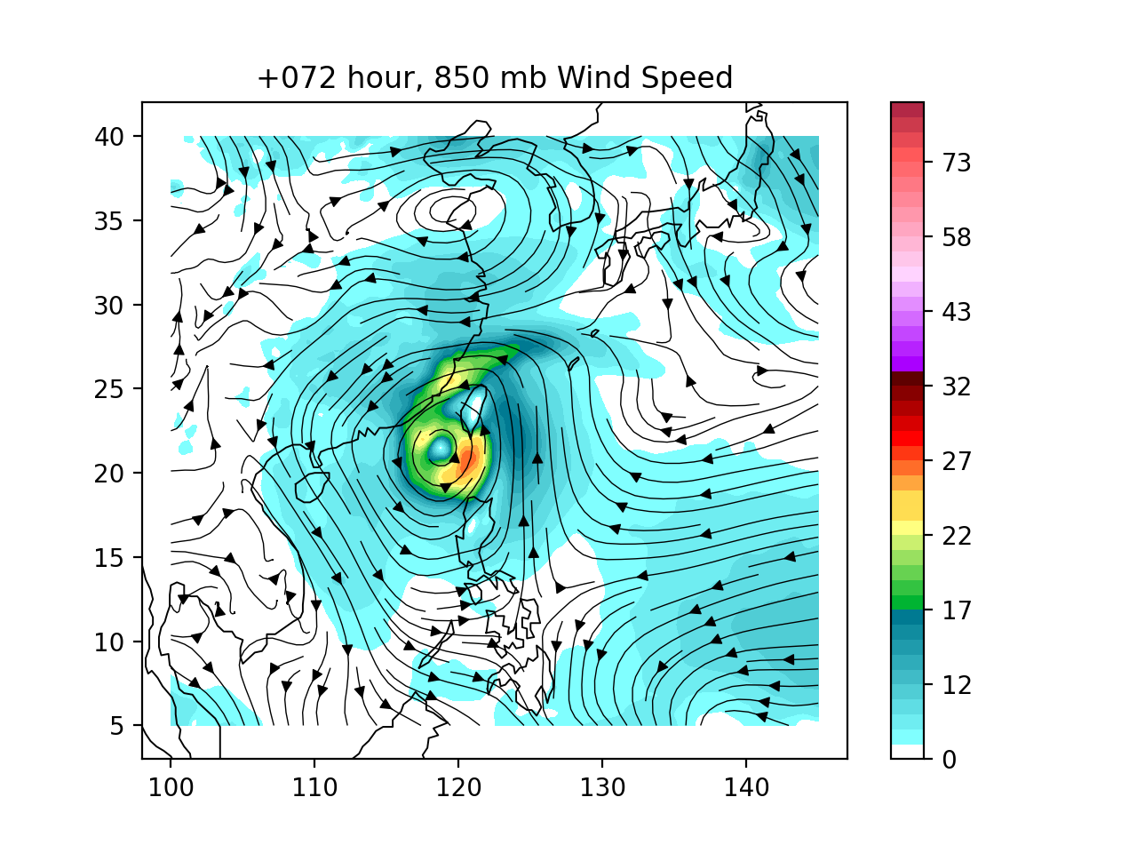
RegPGW++ with FCNv2 B.C. & nudging techniques
No boundary
FCNv2 boundary
FCNv2 nudging

Slide 11
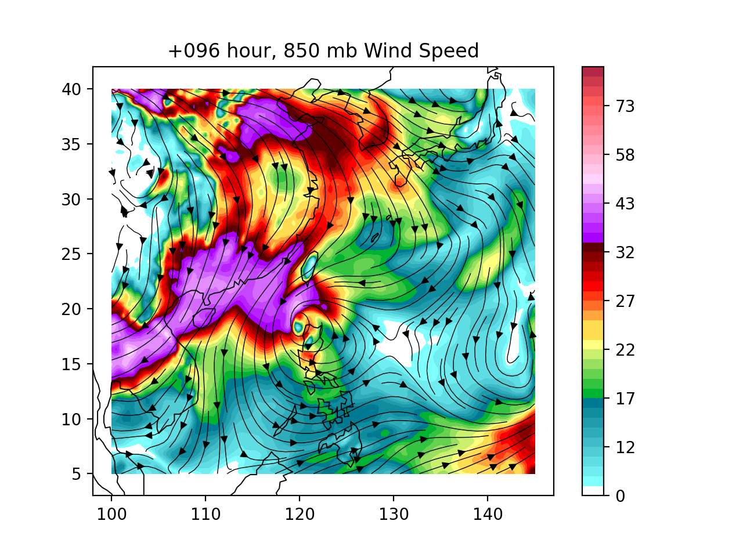
RegPGW++ with FCNv2 B.C. & nudging techniques
No boundary
FCNv2 boundary
FCNv2 nudging

Slide 12

RegPGW++ with FCNv2 B.C. & nudging techniques
FCNv2
FCNv2 boundary
FCNv2 nudging

Slide 13



RegPGW++ with FCNv2 B.C. & nudging techniques
FCNv2
FCNv2 boundary
FCNv2 nudging

Slide 14


RegPGW++ with FCNv2 B.C. & nudging techniques
FCNv2
FCNv2 boundary
FCNv2 nudging

Slide 15



RegPGW++ with FCNv2 B.C. & nudging techniques
FCNv2
FCNv2 boundary
FCNv2 nudging

Slide 16



RegPGW++ with FCNv2 B.C. & nudging techniques
FCNv2
FCNv2 boundary
FCNv2 nudging

Slide 17



RegPGW++ with FCNv2 B.C. & nudging techniques
FCNv2
FCNv2 boundary
FCNv2 nudging

Slide 18



RegPGW++ with FCNv2 B.C. & nudging techniques
FCNv2
FCNv2 boundary
FCNv2 nudging

Slide 19



RegPGW++ with FCNv2 B.C. & nudging techniques
FCNv2
FCNv2 boundary
FCNv2 nudging

Slide 20



RegPGW++ with FCNv2 B.C. & nudging techniques
FCNv2
FCNv2 boundary
FCNv2 nudging

